Slide 1
Introduction to Bihar

Slide 2
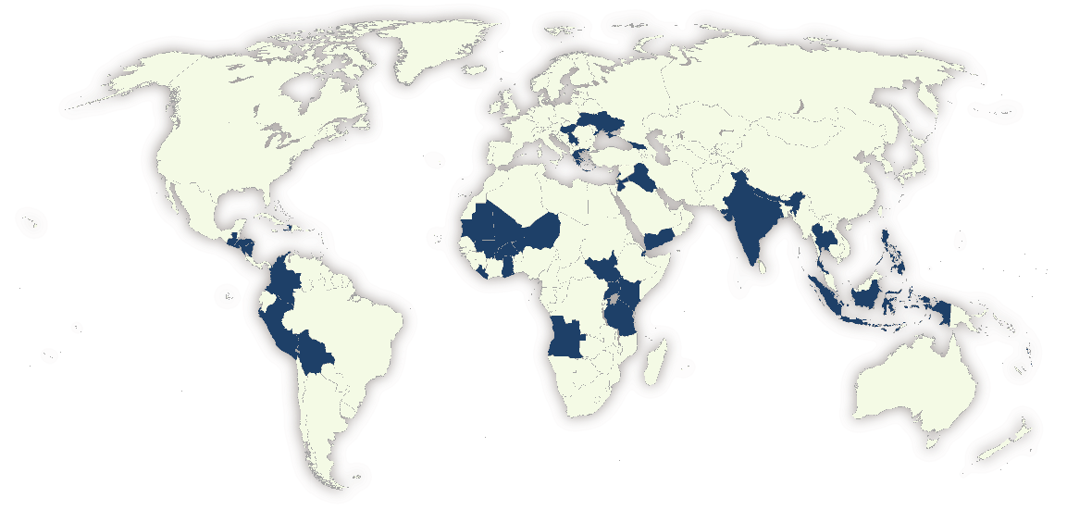
Where We Work

Slide 3
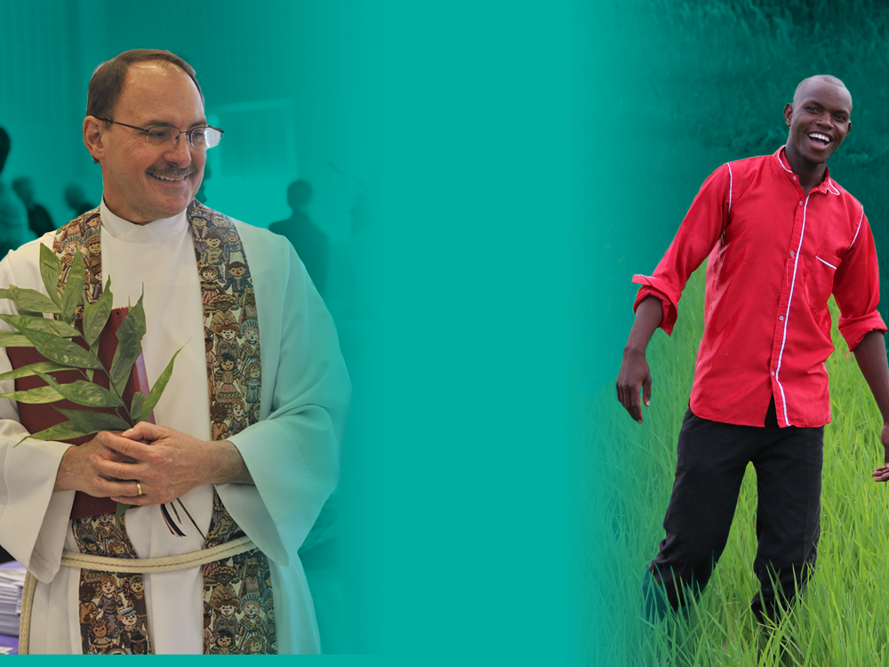
Notes:
The “L” in LWR, and our Theory of Change
We are not a missionary organization in the traditional sense of the word. We do not proselytize, or force people to become Christian in order to get help. We work with all people, regardless of their religion, or creed. Yet we are deeply grounded in the first word of our name.
Martin Luther wrote, “The Christian is a perfectly free lord of all, subject to none; the Christian is a perfectly dutiful servant of all, subject to all.”
It’s within that paradoxical statement that LWR finds our mission and our grounding. Everything we do at LWR is in response to the love of God. We do not need to do anything to earn God’s grace. It’s grace.
But because we are loved, we love others. That is our vocation, to use another strong Lutheran term. We see our neighbor in need. In response to God’s love, we reach out in love to our neighbor.
[IMPORTANT: The following section can get tricky to talk about, and might put certain audiences on edge. Approach with caution; if you do not feel comfortable talking about Lutheran theology, or LWR’s theory of change, please skip ahead to the next section.]
Now, I want you to imagine raising your hand — raise your hand only in your head — if you make more than $34,000 per year. Only in your head!
If your hand is raised (in your head), you are in the world’s richest 1%.(3) $34,000! It doesn’t sound like much, but we in the United States are far more wealthy than most of the rest of the world.
Though many people around the world face diseases of poverty, we in the United States face our own diseases. Affluenza [diseases of affluence], inequality, spiritual wandering.
We at LWR see these two ends of the spectrum as deeply interconnected. We have a lot to teach, as well as a lot to learn! And ultimately, what LWR seeks is not primarily an end to poverty, or an end to hunger. Ultimately what LWR seeks is “full human flourishing” for all people.
This is what we call our “Theory of Change.” That when U.S. Lutherans truly meet their neighbor in communities experiencing poverty, we are all changed for the better. “Full human flourishing” can only be achieved together. It’s a life of dignity, complete with opportunities for happiness, equilibrium and satisfaction.
LWR views the world holistically: that God’s creation is one, and that we are all inter-related. A unified theory of change helps demonstrate these linkages, through its vision of Full Human Flourishing.(4)
3 Branko Milanovic. The Haves and the Have-Nots: A Brief and Idiosyncratic History of Global Inequality. (Basic Books, New York) 2010.
4 LWR Theory of Change. K:\Strategic Planning\Theory of Change. Last accessed 5/15/14.

Slide 4
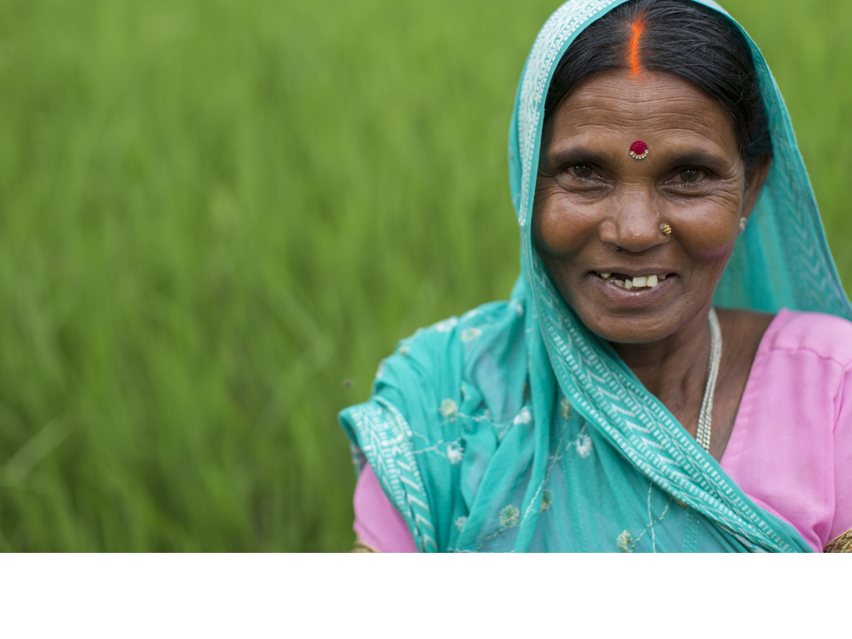
Jake Lyell for LWR
Notes:
Focus on agriculture:
One in eight people in the world, more than 840 million people go hungry every day.
By 2050, the world will need to increase its food production by as much as 50 percent to feed 9 billion people. To do this, the international community must devote attention and resources to agricultural development and research, including a global push to close the “gender gap.” While increasing production, the world must also protect and sustain natural resources, taking specific measures to adapt to changing climatic conditions.
Smallholder producers grow four-fifths of the food in developing countries.
Agriculture not only suffers the impacts of climate change, it is also responsible for 14 percent of global greenhouse gas emissions. While agricultural practices in more developed countries contribute to a significant portion of these emissions, the FAO estimates that 70 percent of the mitigation potential could actually be realized in developing countries.
Societies with greater gender equity experience greater agricultural productivity and improved food security. (1) Yet a persistent gender gap remains in most of the countries where LWR works. If women had the same access to productive resources as men, they could increase yields on their farms by 20 to 30 percent, which in turn could raise total agricultural output in developing countries by 2.5 to 4 percent and reduce the number of hungry people in the world by 12 to 17 percent, up to 150 million people.(2)
Improved access to food can be achieved by increasing and diversifying household food production, increasing household income and consumption, and reducing the cost of obtaining food.
For households whose livelihoods are based entirely, or in part, on agriculture, limited access to land, water and other natural resources is often a leading cause of poverty. In addition, women-headed households are often those most affected by insecure or insufficient access to key natural resources.

Slide 5
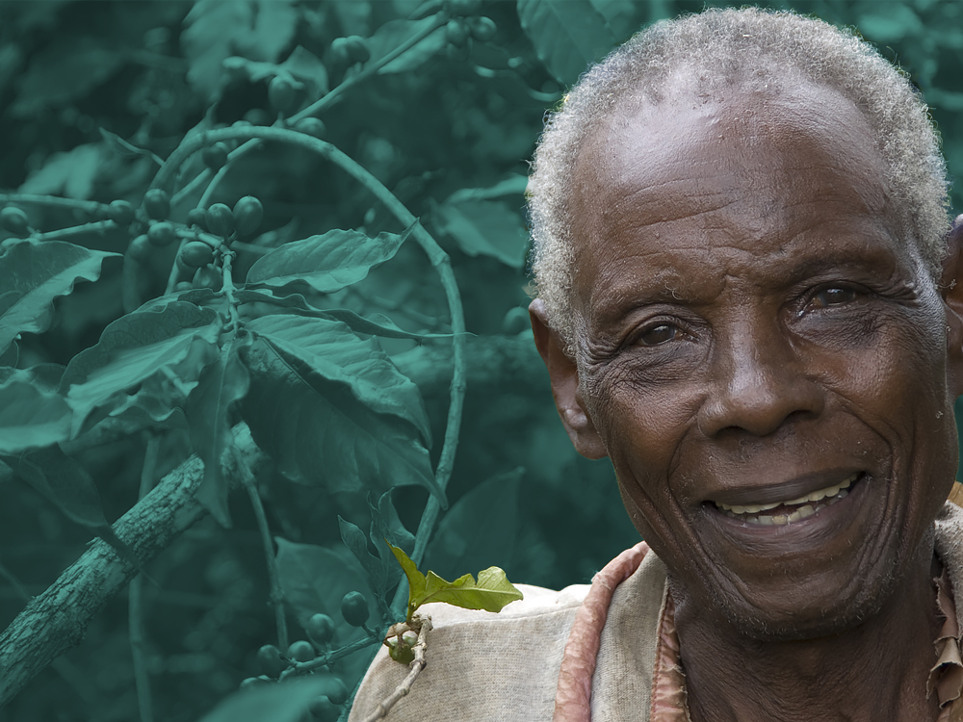

Slide 6
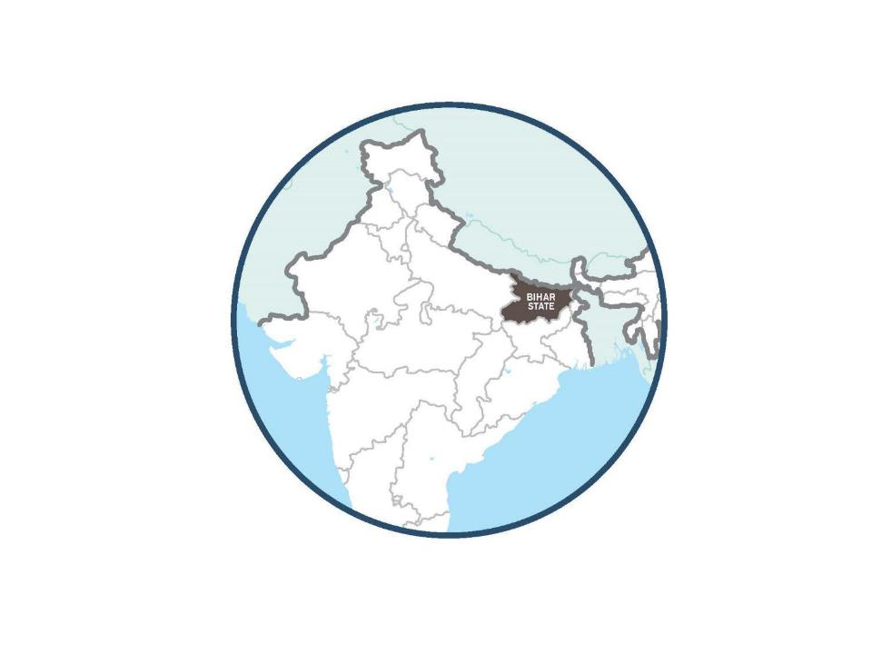
Bihar State
3rd most populated state
Majority marginalized
Low literacy rates
High poverty
Notes:
Bihar stats:
54% are at or below the poverty line (compared with 21% for India as a whole)
109M people
Total literacy is 47%, which drops to 43% in rural areas, and of those rural areas, for women it’s 29% literate.
It’s the 3rd most populated state in India, but the majority are also the most marginalized- Dalits (formerly untouchables), tribals, and OBC – “other backwards caste” with only 15% in the “upper castes”
Traditional communities, rural, agrarian (contrast to what stereotypes we think of with India as IT hub and tech capital in the world)
LWR has a strong partnership and long history in this area: we’ve been working in India since the 1950s!

Slide 7

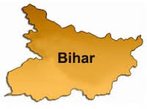

In terms of size, at 38,301 mi² the state of Bihar is slightly larger than Maine and slightly smaller than Indiana.
Notes:
For US size reference
And population comparison again – Bihar has 109M people, the state of Indiana has roughly 6.6M people

Slide 8
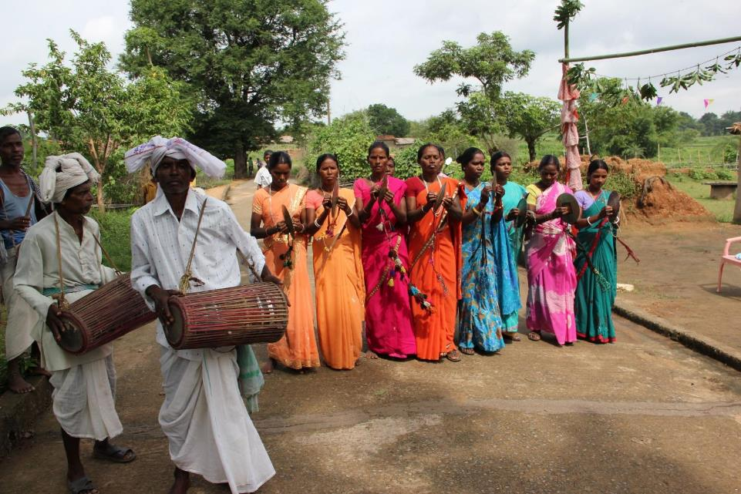
Notes:
Setting the stage--- in Bihar, most families are poor, rely on money lenders who charge exorbitant rates to meet any urgent cash needs (if someone gets sick and needs medicine, if they run out of food, etc) and most have food security for only 3-5 months of the year.
Men often migrate for work as day laborers in nearby cities, and so women do most everything – take care of the house and children, work on the farm, and many often get up at 3/4am and go to collect non-timber forest products (kindling/leaves) from the woods to sell for small change…. Anything to help add to the HH’s limited resources.
Because of the multi-faceted role that women play in keeping the family going, our approach and our focus starts with them.
Women members of Towabaha SHG and Kusmibaha SHG and their male family members are welcoming LWR in their Village namely Bagapothar with their traditional musical instruments-Dhansa & Mandal.

Slide 9
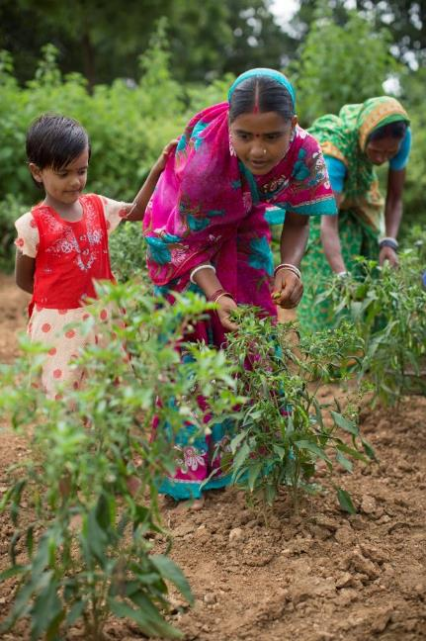
Goals:
Organizing and equipping women in the community
Agricultural improvements
Year-round food security for the family
Increased income for most families
Notes:
The project seeks to accomplish several goals –
Start with the women in the community, bring them together, strengthen their ties and create self-help groups. This not only offers us a way “in” for delivering our training and sharing information, but they also begin a small savings and loan program that they control themselves, setting them on a path to self-sufficiency and breaking the cycle of predatory lending from nearby money lenders.
Agricultural improvements – training in best practices, introducing time saving tools that help with weeding and other ag tasks, introduction of new crops to diversify their diets and their feasibility for sales in the local market. (one real key point here is about time saving – it’s a huge boon given all the tasks women do during the day, and the innovative nature of the tools also gets their husbands involved in tasks that were previously viewed as “women’s work”)
Year-round food security…. Moving from 3-5mos of food to 12 months. And impacting the diversity of diet. Going from near starving when a family might rely on a meal of rice cooked in water with some leaves to having variety of rice, wheat, lentils, vegetables.
Increased income – this isn’t always true for all, it’s normally the last stage of the project, after everyone has achieved year round food security, that we’re then focused on market linkage and helping them sell the surplus production. In past projects, the majority of households do attain increased income by end of the project and that bolsters their ability to cover things like medical expenses, funerals/weddings/other ceremonies, tuition and expenses for kids to go to school, etc.

Slide 10
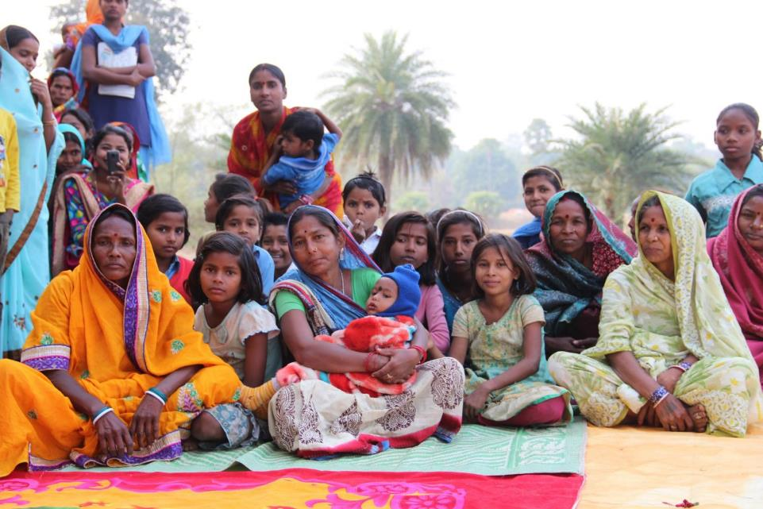
Notes:
It all begins with organizing– here in self help groups
Banding together to lift each other up
Community decisionmaking
Advocating for policy changes in the local government
Credit and loan systems
System of trust
Picture from Jan. 2016 site visit to Hetsonari, Bihar.
Hetsonari has five SHGs with 53 members total. The women of Hetsonari have been so successful with their SHGs that they are now going out to other villages to help other women form SHGs of their own. They’ve so far have helped establish 7 new SHGs. The women say they are able to save on average 20 rupees per week/person, and this savings is held collectively by the SHG and used for member loans. The SHGs plan to use their united voice to ask the government for education and further irrigation support.

Slide 11
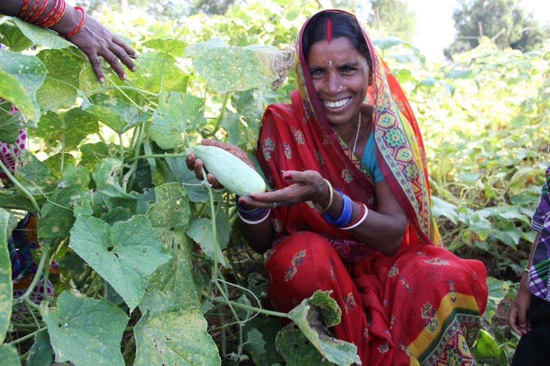
Notes:
Another example of recent project work in Bihar, similar to what we will be doing together:
Sumitra Devi in her land where cultivated cucumber. cucumber is consumed as dessert in Sumitra's family as the children of her family relishes cucumber. Sumitra's cucumber cultivation this season was relatively better than the last season as she was able to cultivate for home consumption as well as sell some portion of it in the local market. Village name : Dokri

Slide 12
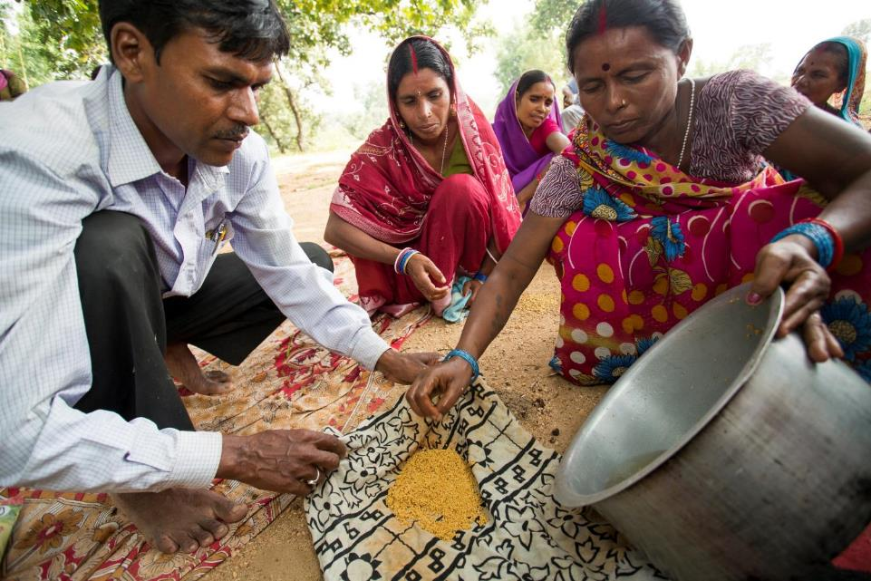
Notes:
Technology and education: high-yield seeds and seed treatments
LWR beneficiaries attend a seed treatment training session by Village Resource Person Rajendra Mahto (left)
Lutheran World Relief - India.Sept. 2013 - Agricultural Programs in Banka District, India.Photograph by Jake Lyell

Slide 13
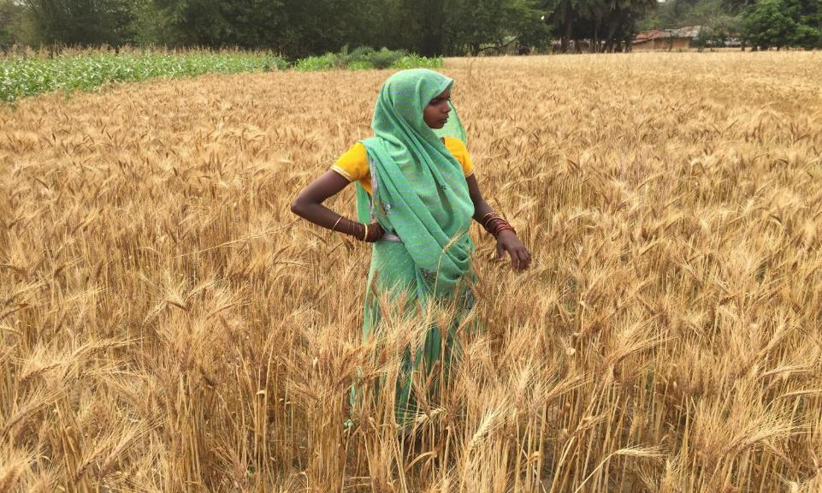
Notes:
Higher yields = greater income as well as more food for the family

Slide 14
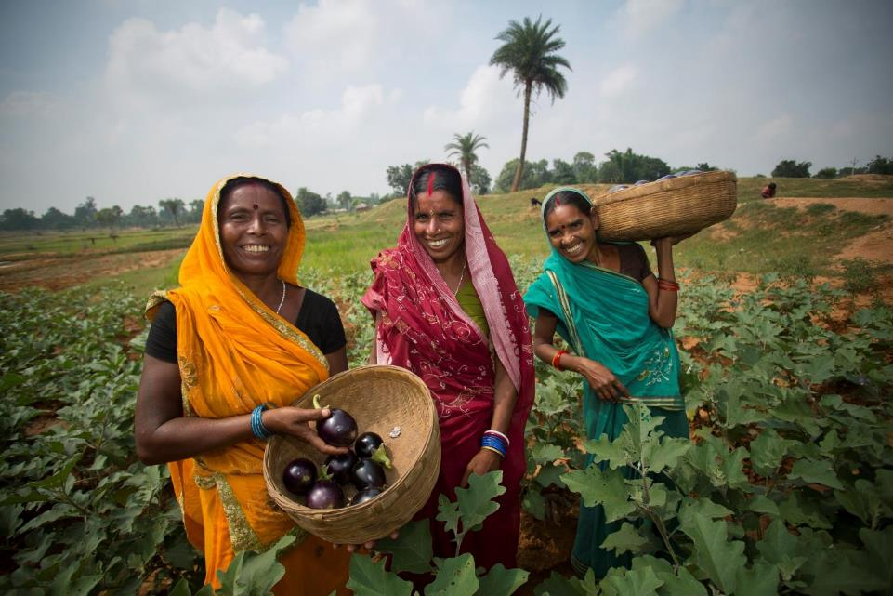
Notes:
Introduction of new crops– building better nutrition as well as greater resiliency
(left to right) LWR beneficiaries Geeta Devi, Sumitra Devi, and Mina Devi, stand in their eggplant field
Lutheran World Relief - India.Sept. 2013 - Agricultural Programs in Banka District, India.Photograph by Jake Lyell

Slide 15
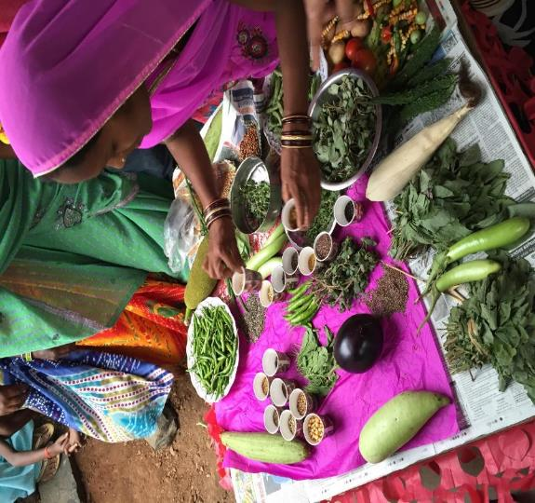
Notes:
Greater variety means better soil, better yields, better nutrition, and higher incomes
Start growing crops that have higher market value
Training for how to cook with newly introduced veggies

Slide 16
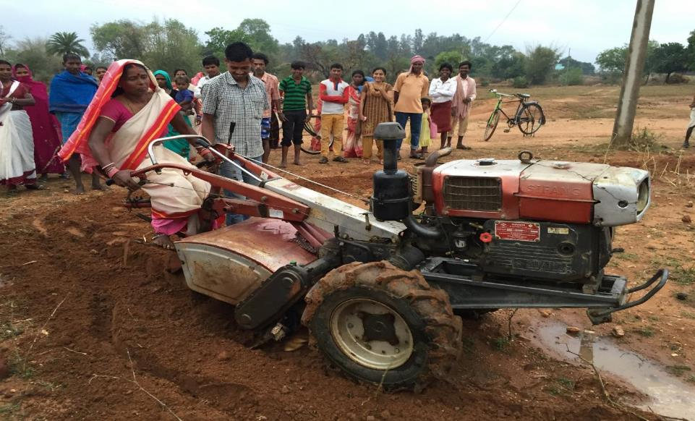
Notes:
Mechanical ripper

Slide 17
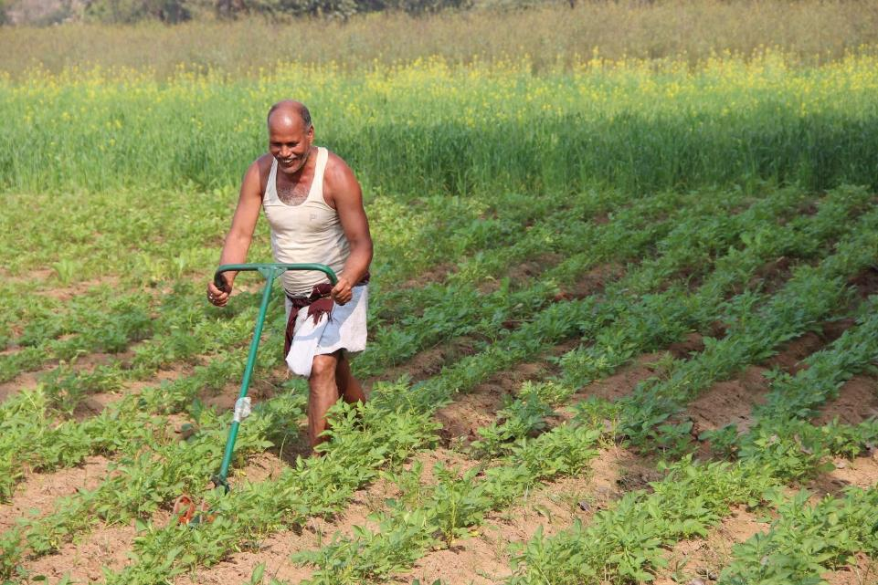
Notes:
Better farming technologies and training– save time, increase yields
Increased yields can lead to increased income, which has meant for many families that men no longer have to migrate for work
Now, both husband and wife can work on the plot and see the benefits of their ag production
Better for HH dynamics as well – men are supportive of their wives’ new knowledge and the benefits it brings to the family, women have more of a say in the crops chosen and the division of labor
Picture from Jan. 2016 site visit to Barmasia, Bihar.
Pictured: Man uses tools provided by LWR.
Barmasia has 150 households and 5 SHGs. Since forming the SHGs and participating in LWR’s trainings, the women have become more outspoken, both in the home and civically. The organization of the SHGs has helped them be free from money lenders as the women can now contribute to a general savings account from which SHG members are allowed to borrow at low interest rates. Thanks to the construction of wells and a new pump irrigation system, they can grow crops outside of the monsoon season, so they have year-round food security. Because of the improved farming practices and technologies introduced to Barmasia, their annual yields have increased so significantly that fewer men have to migrate for work and can stay to help farm. The women have been trained on how to create organic fertilizer and pesticides, skills which they now fully employ because they see the positive effects on their health.

Slide 18
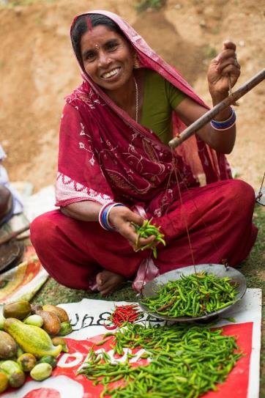
Increased Incomes = Increased Choice
Family health needs
Education
Migration
Quality of Life

Slide 19
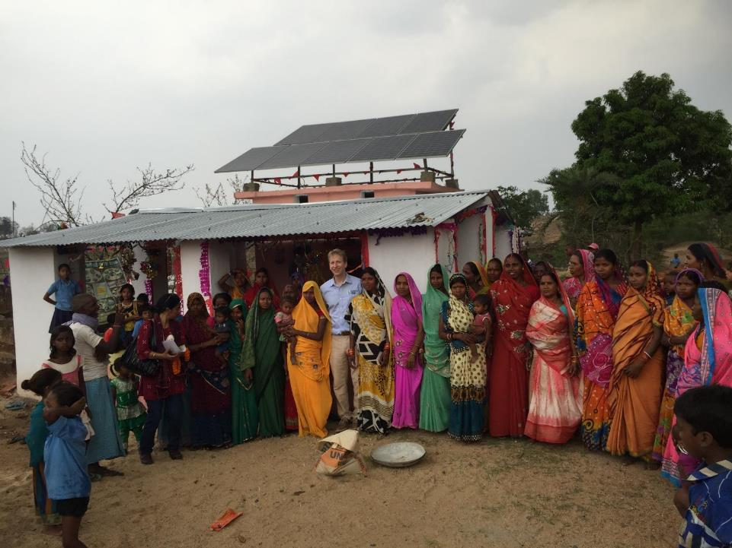
Notes:
Daniel’s story:
“What more can LWR do to support you?”
The women discussed among themselves and answers, “The village down the road needs help– can you give them the same help you gave us?”
Together, we can build on what LWR has started and reach new communities in desperate need.

Slide 20
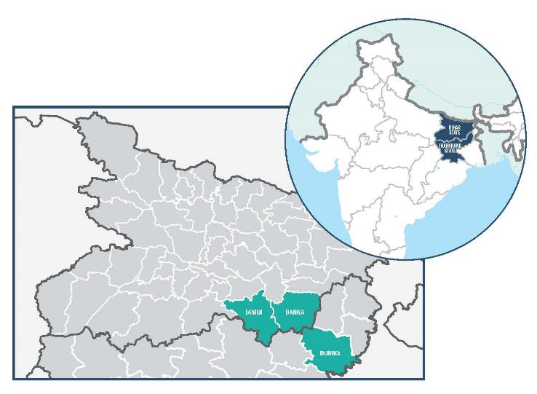
Notes:
we can now say we’ll be reaching 4,000 families.
Also can add Daniel’s point about scale and neighboring economies – lifting one community out of poverty isn’t enough if they’re surrounded by others who haven’t seen that success, we need to look at a bigger picture where we can have an impact at a macro level, and do this for several communities. Strength in numbers as the women self-help groups grow and form federations, whereby they can advocate at local govt and continue on to be a voice for their community.

Slide 21
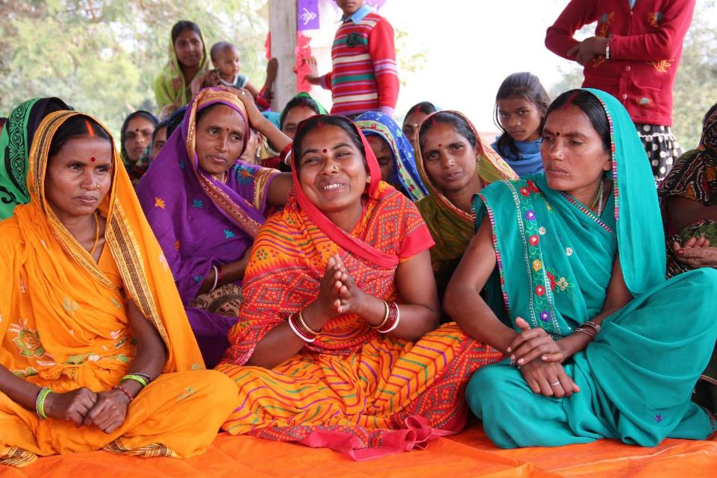
Notes:
Women as drivers of change
They are the ones at home while the men migrate for work
They are the ones who farm and also the ones who take care of the family
Picture from Jan. 2016 site visit to Barmasia, Bihar.
Pictured: Rehka (center) is on the board of the SHG federation.
Barmasia has 150 households and 5 SHGs. Since forming the SHGs and participating in LWR’s trainings, the women have become more outspoken, both in the home and civically. The organization of the SHGs has helped them be free from money lenders as the women can now contribute to a general savings account from which SHG members are allowed to borrow at low interest rates. Thanks to the construction of wells and a new pump irrigation system, they can grow crops outside of the monsoon season, so they have year-round food security. Because of the improved farming practices and technologies introduced to Barmasia, their annual yields have increased so significantly that fewer men have to migrate for work and can stay to help farm. The women have been trained on how to create organic fertilizer and pesticides, skills which they now fully employ because they see the positive effects on their health.

Slide 22
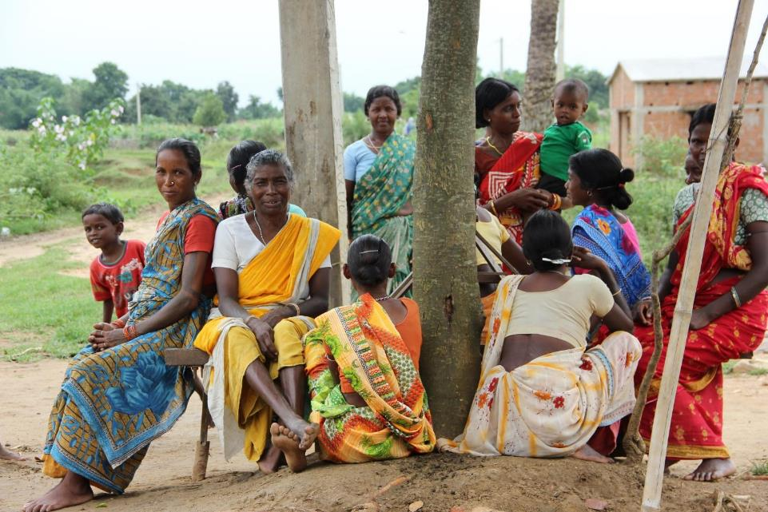
Notes:
The women SHG members from Ganaiya Village gather outside following the group interview with LWR and ASA staff as part of the LGI Needs Assessment.

Slide 23
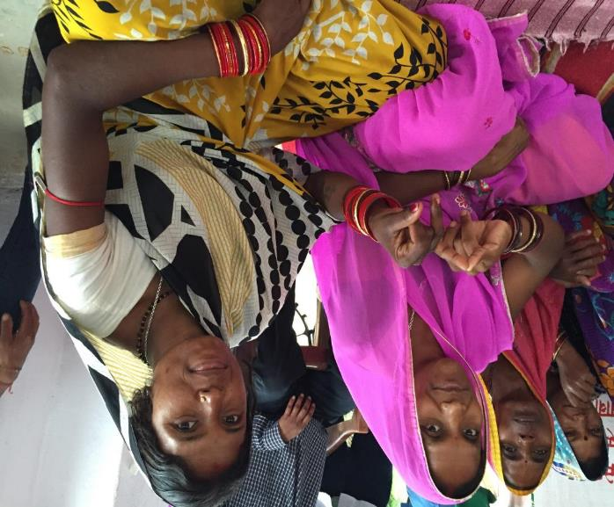

Slide 24
lwr.org
800.597.5972
Affirming God’s love for all people, we work with Lutherans and partners around the world to end poverty, injustice and human suffering.

