Slide 1
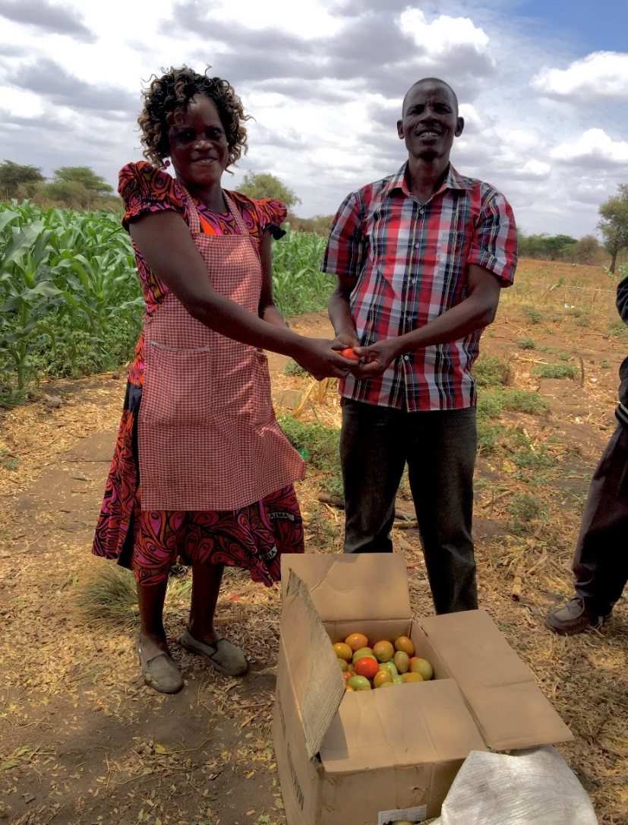
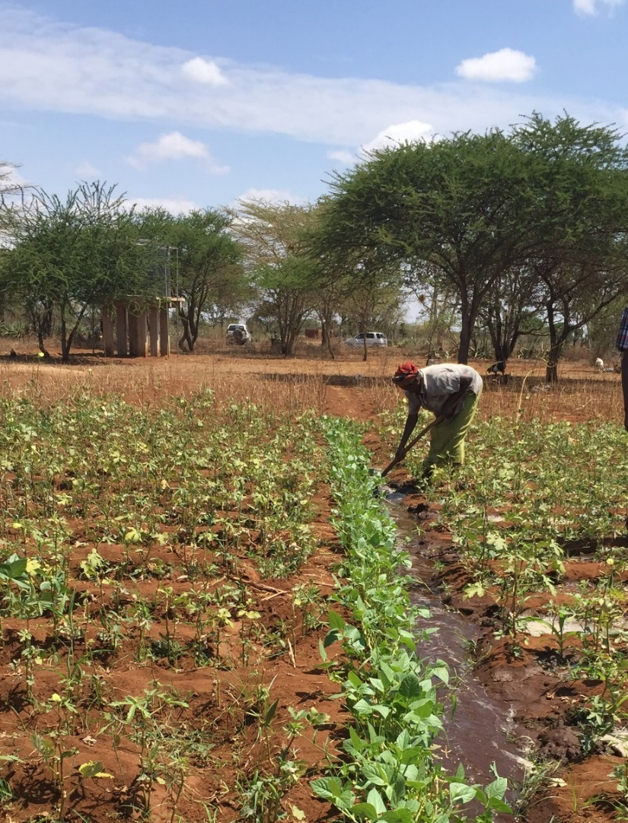
Kenya Farmers whose families and lives have been changed by LWR…
“The life we have is
due to the LWR.”
“ Zion is here!
God has remembered us!”

Slide 2
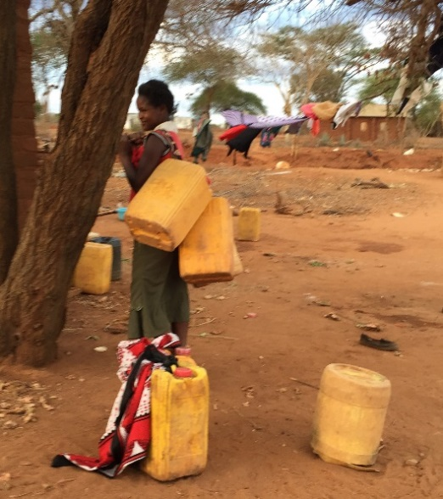
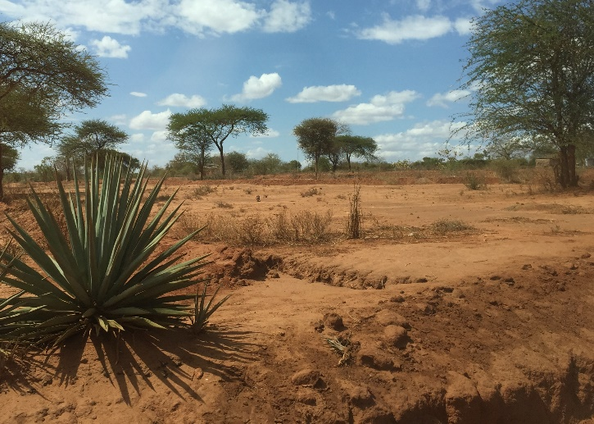
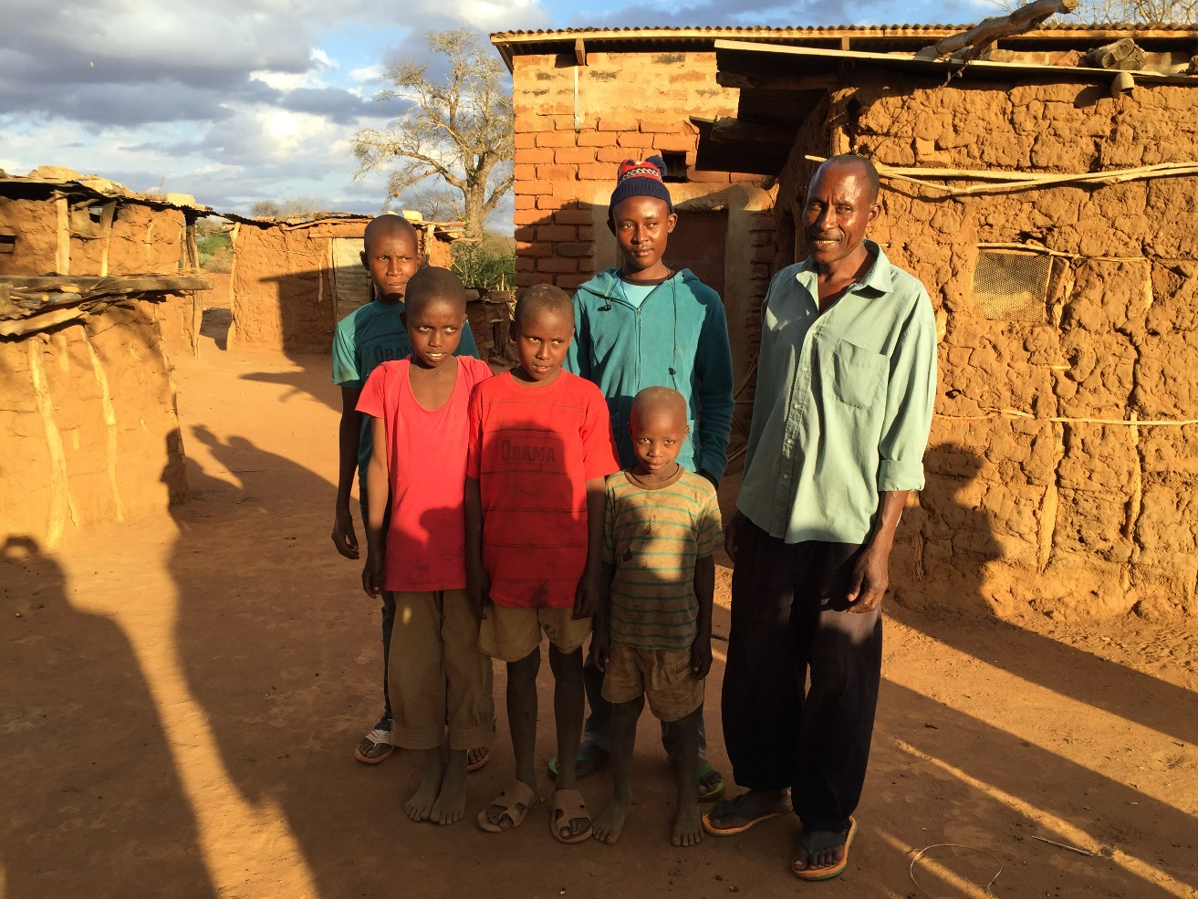
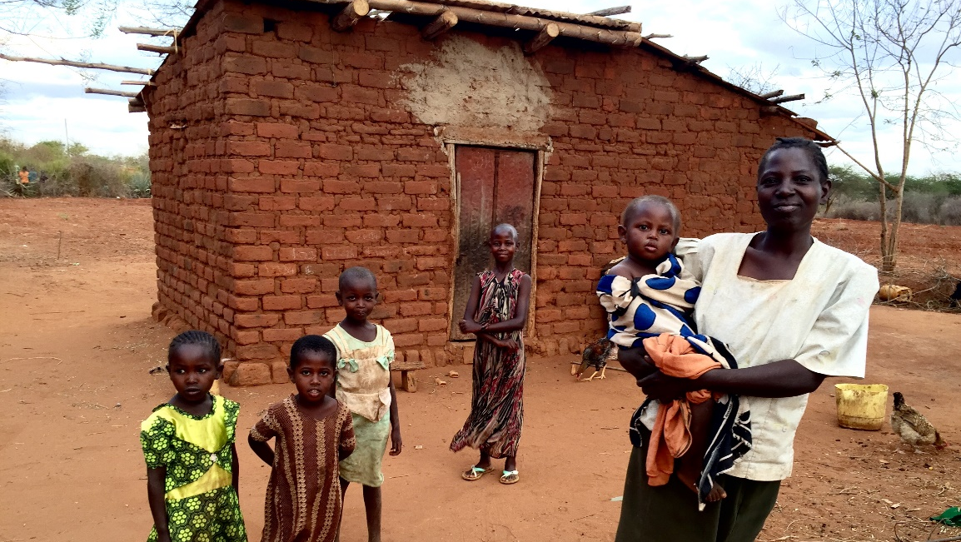
Kenyan Families who are waiting for our help…
Masongaleni. Resettled from the Chyulu Hills National Park. Government burned their homes. Forcibly moved to arid, difficult land.

