Slide 1

Project Update #1: Fall 2017

Slide 2
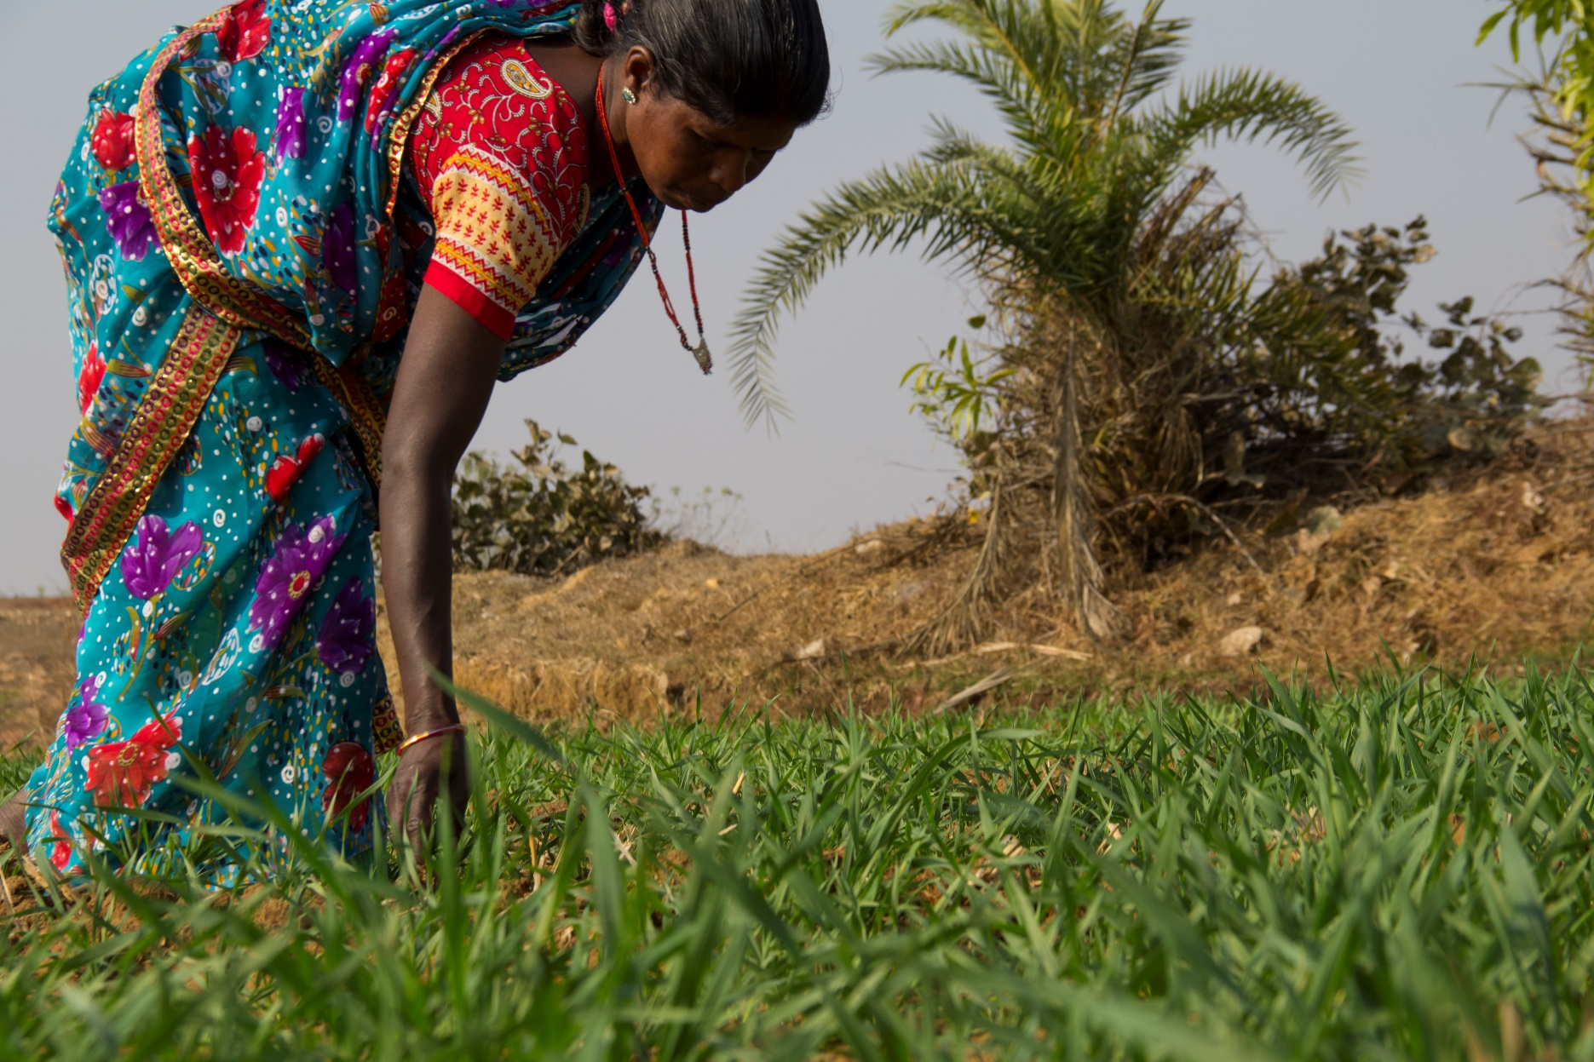

Slide 3
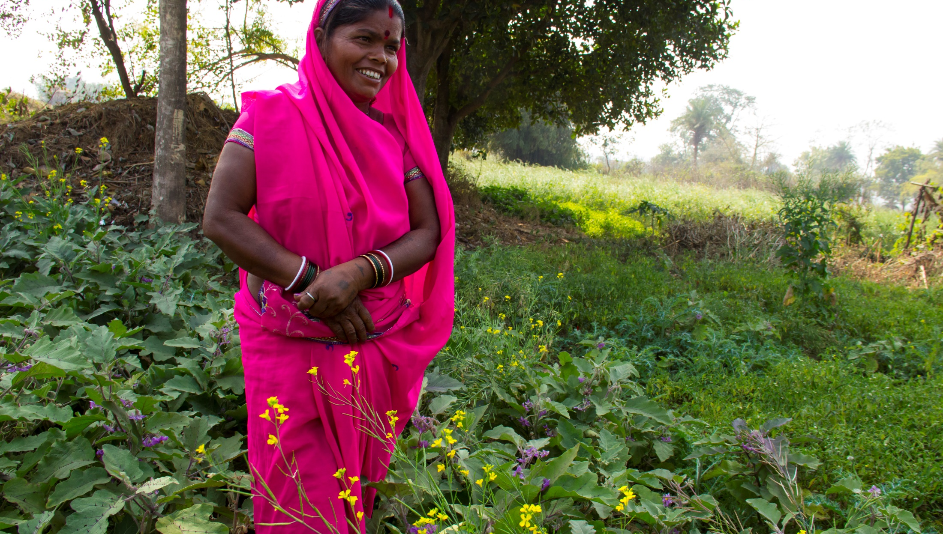

Slide 4
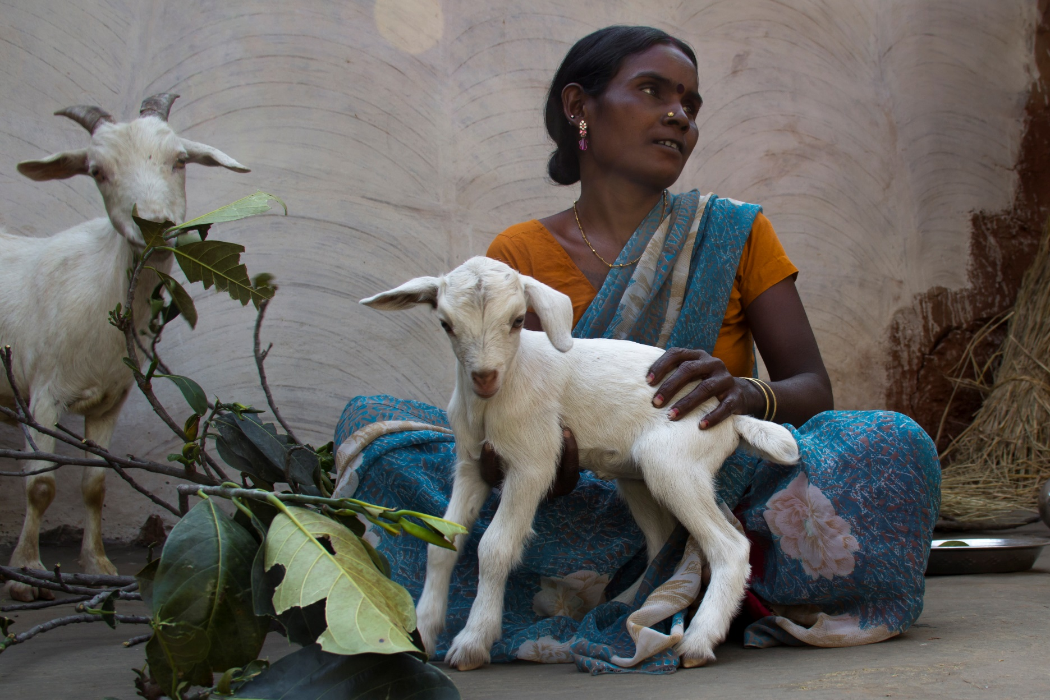

Slide 5
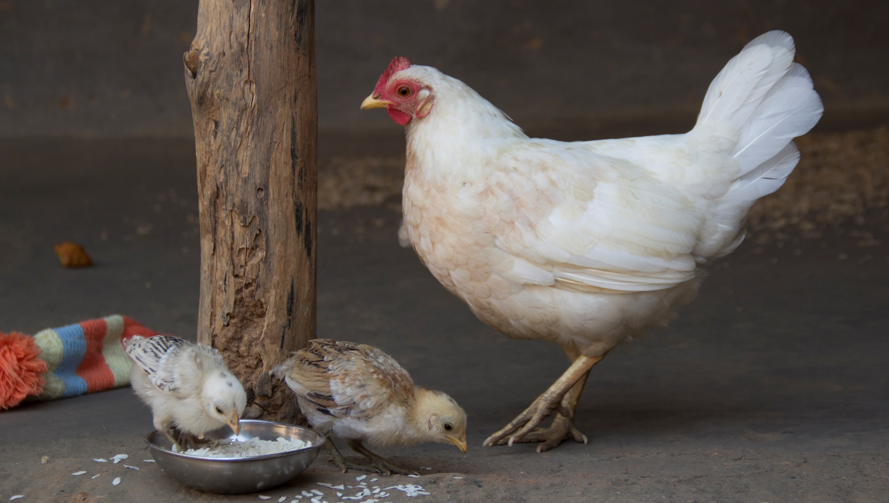

Slide 6


Slide 7
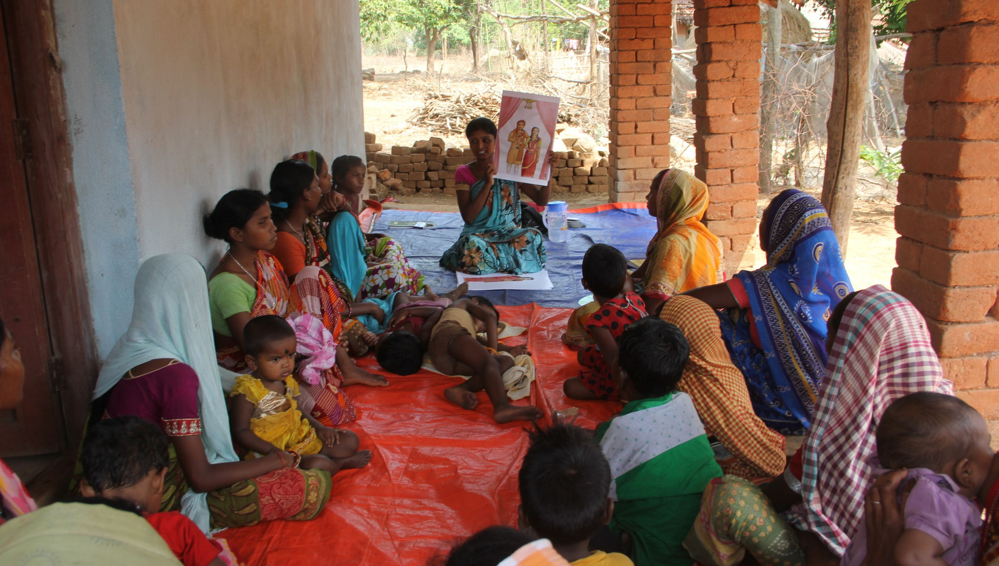

Slide 8
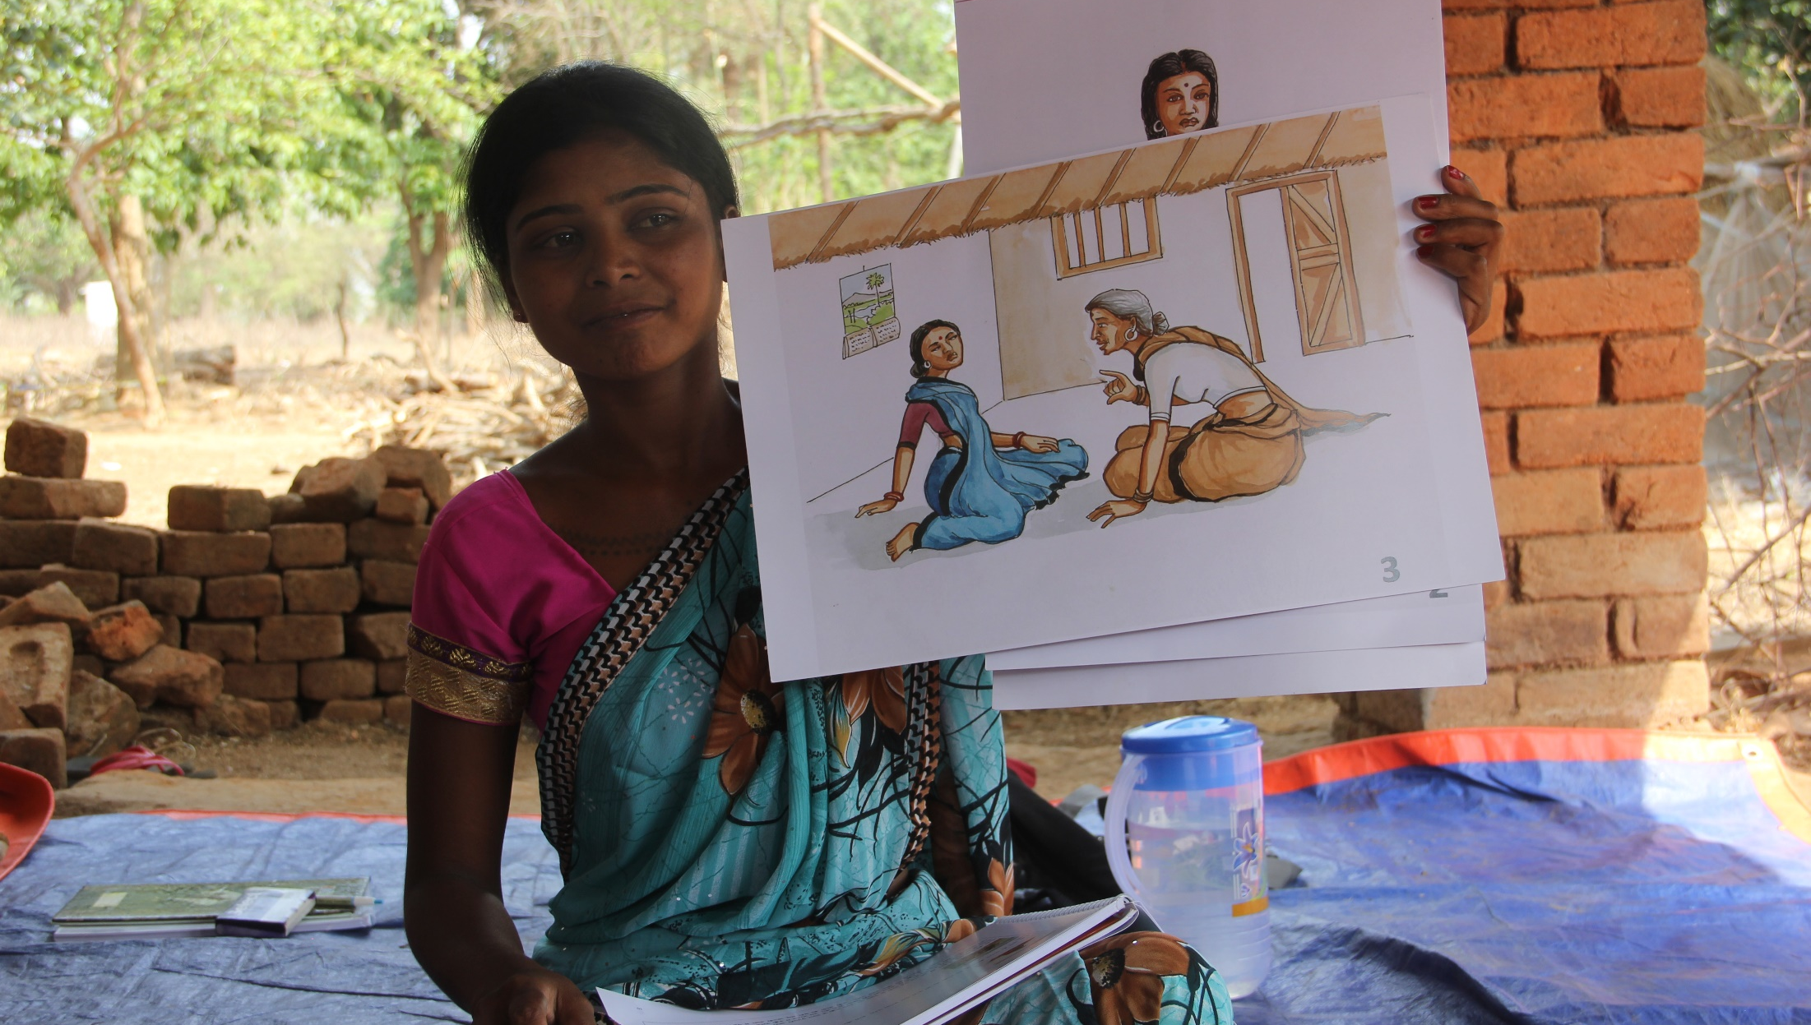

Slide 9
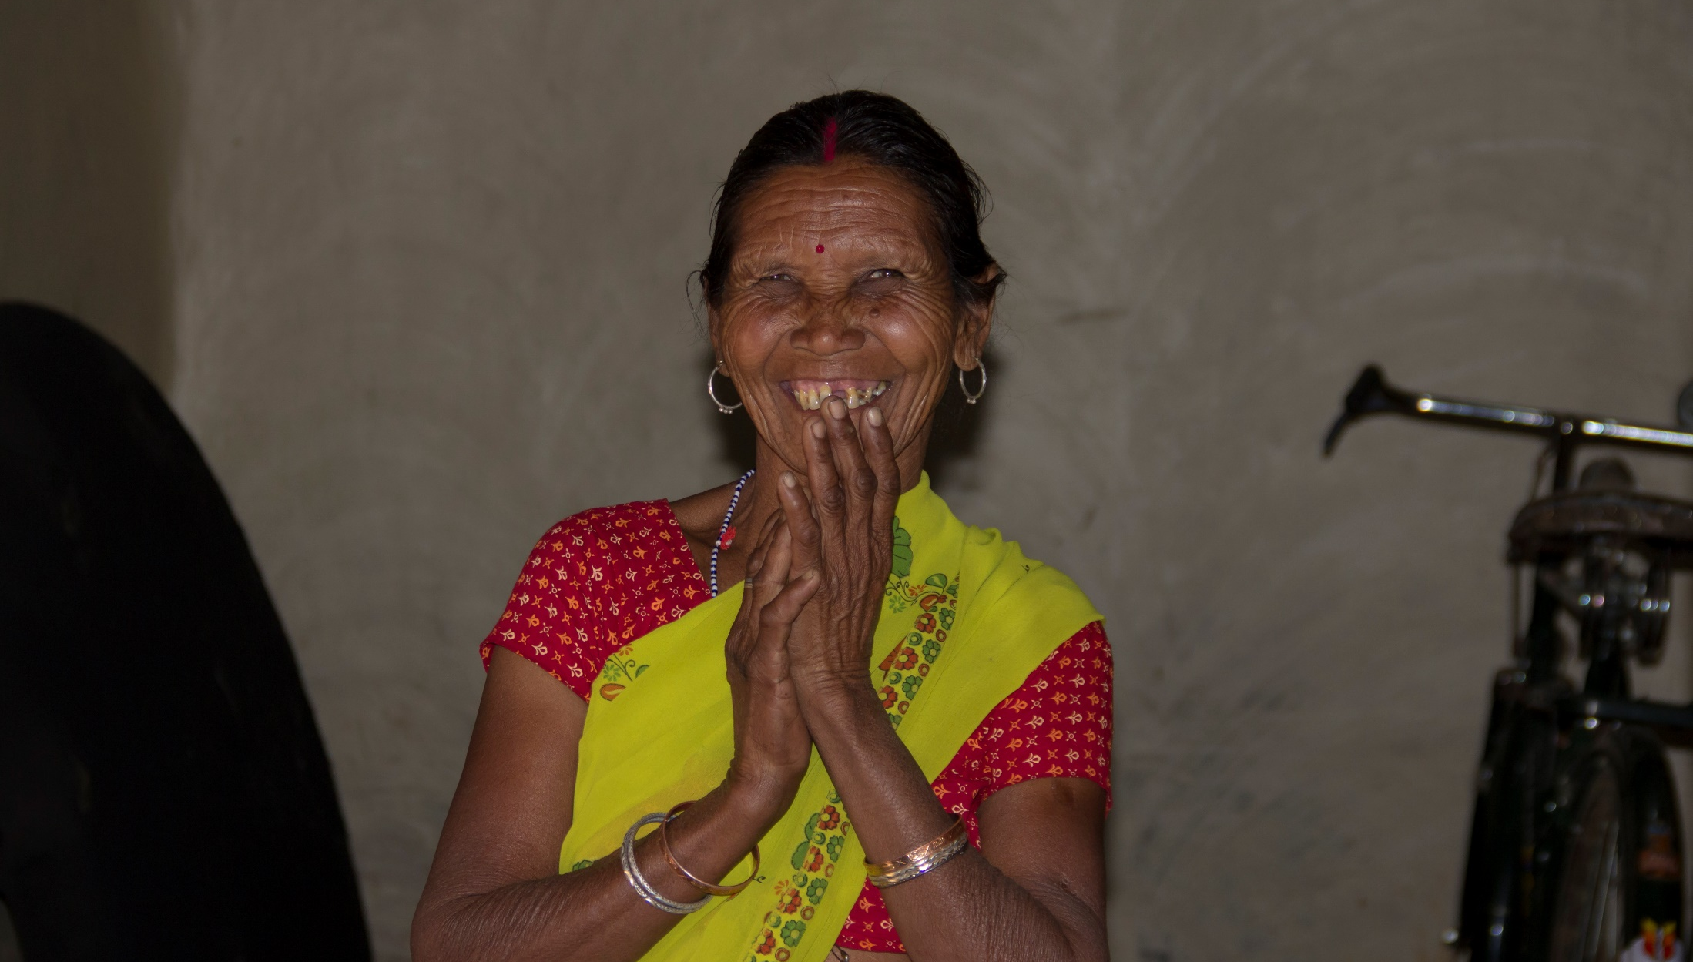

Slide 10
lwr.org
programs.lwr.org
800.597.5972
Affirming God’s love for all people, we work with Lutherans and partners around the world to end poverty, injustice and human suffering.

